Slide 1
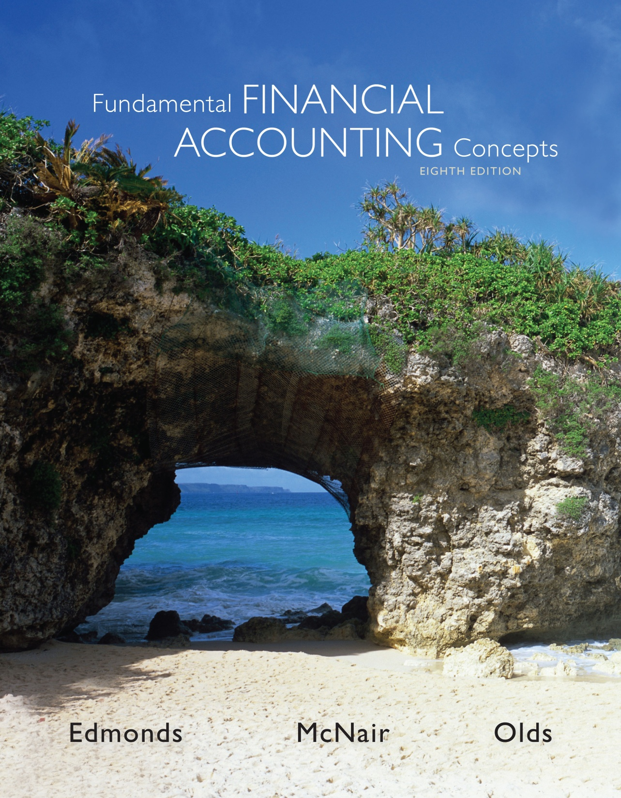
Chapter Five
Accounting
for
Inventories
McGraw-Hill/Irwin
Copyright © 2013 by The McGraw-Hill Companies, Inc. All rights reserved.
McGraw-Hill/Irwin
Notes:
In this chapter, we will introduce four inventory cost flow methods.

Slide 2
Inventory
Inventory is tangible property that is held for resale or will be used in producing goods or services.
Inventory is reported on the balance sheet as an asset.
Types of inventory:
  Merchandise inventory
  Raw materials inventory
  Work in process inventory
  Finished goods inventory
manufacturer

Slide 3
Inventory Cost
The cost principle requires that inventory be recorded for the price paid or the consideration given up.
What type of transaction is the purchase of inventory?

Slide 4
Inventory Cost
The amount recorded for inventory should include:
  Invoice price (minus purchase discounts), transportation-in costs (also called “freight-in”), inspection costs, and preparation costs.
The company should accumulate costs of purchases until raw materials are ready for use or until merchandise is ready for shipment to customers.

Slide 5
Cost of Goods Sold
Beginning inventory
Add: Purchases (net)
Cost of Goods Available for Sale
Deduct: Ending inventory
Cost of goods sold
Cost of Goods Available for Sale expresses the total cost of what has been available for sale throughout a given time period.

Slide 6

Periodic Inventory Systems
Because entries are not made to the inventory account during the accounting period, the amount of inventory is not known until the end of the period when the inventory count is done.
Th PERIODIC system is being used less and less e due to advancements in technology that make the extra record keeping of the perpetual system easy and inexpensive.
Periodic inventory systems require more closing entries at the end of the period. (Purchases, Purchase Returns and Allowances, Purchase Discounts, and Transportation In are all separate TEMPORARY accounts that must be closed out at the end of the period.)
Notes:
The Cost of Goods Sold schedule is used for internal purposes only! It is not shown on the financial statements. Cost of goods sold is reported as one line on the income statement, just as it would be in a perpetual system.

Slide 7
Inventory Cost Flow Methods
Specific Identification
First-in, First-Out (FIFO)
Four Common Inventory Cost Flow Methods
Last-in, First-Out (LIFO)
Weighted Average
Notes:
Four common inventory cost flow methods are
Specific identification
First-in, first-out
Last-in, first-out and
Weighted average.

Slide 8

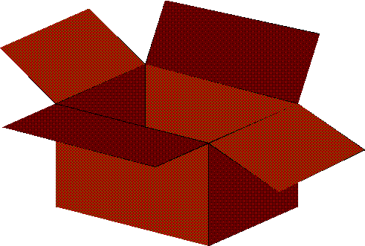
Inventory Cost Flow Methods
These four inventory costing methods are used to assign the total dollar amount of goods available for sale between ending inventory and cost of goods sold.
Ending
inventory
or CGS??
Notes:
10

Slide 9
Inventory Account
Inventory
Beginning Balance
100 units @ $3
Units Sold
Purchases during the period
150 units $3.10
200 units sold
100 units $3.05
200 units $3.15
Ending Balance

Slide 10
Inventory Account
Inventory
Beginning Balance
100 units @ $3
Sold 200 units
Purchases during the period
150 units $3.10
What is CGS??
100 units $3.05
200 units $3.15
Ending Balance
= 350 units
What is EI??

Slide 11
Specific Identification
When a company’s inventory consists of many high-priced, low-turnover goods the record keeping necessary to use specific identification is more practical.
Notes:
When a company’s inventory consists of many high-priced, low-turnover goods the record keeping necessary to use specific identification is more practical.

Slide 12
Specific Identification
Assume Baker Company purchased two identical inventory items: the first for $130 and the second for $140.
Using specific identification, when the first item is sold, cost of goods sold would be $130. When the second item is sold, cost of goods sold would be $140.
Notes:
Assume Baker Company purchased two identical inventory items: the first for one hundred dollars and the second for one hundred ten dollars.
Using specific identification, when the first item is sold, cost of goods sold would be one hundred dollars. When the second item is sold, cost of goods sold would be one hundred ten dollars.

Slide 13
First-In, First-Out
The cost of the oldest inventory items are charged to cost of goods sold when goods are sold.
The cost of the newest inventory items remain in ending inventory.
The actual physical flow of inventory items may differ from the FIFO cost flow assumptions.
Notes:
14
Cost of the items purchased first are assigned to Cost of Goods sold.

Slide 14
Example:
Date Event Units Price Total
1/1 Beg. Inv. 10 $ 4 $ 40
3/10 Purchase 12 7 84
9/15 Purchase 11 8 88
12/27 Sale 18 15 270
When applying FIFO, LIFO, W. Ave. on a Periodic inventory basis it does not matter WHEN the SALES were made.
Notes:
20

Slide 15
FIFO:
Cost of Goods Sold: (for the 18 units sold)
From Units Price Cost
Ending Inventory: (for 15 units remaining)
From Units Price Cost
Notes:
22

Slide 16
FIFO: (Periodic basis)
Cost of Goods Sold: (for the 18 units sold)
From Units Price Cost
1/1 10 $ 4 $ 40
3/10 8 7 56
Totals 18 $ 96
Ending Inventory: (for 15 units remaining)
From Units Price Cost
3/10 4 $ 7 $ 28
9/15 11 8 88
Totals 15 $116
Notes:
23

Slide 17
Last-In, First-Out
The cost of the newest inventory items are charged to cost of goods sold when goods are sold.
The cost of the oldest inventory items remain in ending inventory.
The actual physical flow of inventory items may differ from the LIFO cost flow assumptions.
Notes:
15
Cost of the items purchased last are assigned to Cost of Goods sold.

Slide 18
LIFO:
Cost of Goods Sold: (for the 18 units sold)
From Units Price Cost
9/15 11 $ 8 $ 88
3/10 7 7 49
Totals 18 $137
Ending Inventory: (for 15 units remaining)
From Units Price Cost
3/10 5 $ 7 $ 35
1/1 10 4 40
Totals 15 $ 75
Notes:
25

Slide 19
Weighted-Average
Compute cost of goods available for sale:
  Cost of Beginning Inventory + Net Cost of Purchases
Compute total units available for sale:
  Units in Beginning Inventory + Units Purchased
Notes:
16

Slide 20
Weighted-Average
Compute weighted-average cost per unit:
  Cost of Goods Available for Sale
  Total Units Available for Sale
Compute ending inventory:
Units in EI × Weighted-Average Cost per Unit
Compute Cost of Goods Sold:
Units Sold × Weighted-Average Cost per Unit
Notes:
18

Slide 21
Weighted Average:
Average cost per unit:
Cost of Goods avail. for sale
# of units avail. for sale
Notes:
27

Slide 22
Weighted Average: (Periodic basis)
Average cost per unit:
Cost of Goods avail. for sale $ 212
# of units avail. for sale
Notes:
27

Slide 23
Weighted Average: (Periodic basis)
Average cost per unit:
Cost of Goods avail. for sale $ 212
# of units avail. for sale 33 units
Notes:
27

Slide 24
Weighted Average: (Periodic basis)
Average cost per unit:
Cost of Goods avail. for sale $ 212
# of units avail. for sale 33 units
= $6.42
Per unit
Notes:
27

Slide 25
Weighted Average: (Periodic basis)
Average cost per unit:
Cost of GAFS $ 212
# of units GAFS 33
Cost of Goods Sold:
Ending Inventory:
= $6.42/unit
Notes:
27

Slide 26
Weighted Average: (Periodic basis)
Average cost per unit:
Cost of GAFS $ 212
# of units GAFS 33
Cost of Goods Sold:
  18 units sold @ $6.42 cost = $116 (rounded)
Ending Inventory:
= $6.42/unit
Notes:
28

Slide 27
Weighted Average: (Periodic basis)
Average cost per unit:
Cost of GAFS $ 212
# of units GAFS 33
Cost of Goods Sold:
  18 units sold @ $6.42 cost = $116 (rounded)
Ending Inventory:
  15 units remaining @ $6.42 cost = $ 96 (rounded)
= $6.42/unit
Notes:
29

Slide 28
Income Statements
[Given operating expenses of $50 and a 40% tax rate]
(18@$15)=
FIFO LIFO Wt. Avg.
Sales $270 $270 $ 270
Cost of G. S. 96 137 116
Gross Margin 174 133 154
Oper. exp. 50 50 50
Pretax Inc. 124 83 104
Taxes (40%) 50 33 42
Net Income $ 74 $ 50 $ 62
Notes:
35

Slide 29
Effect of Cost Flow on Balance Sheet
Since total product costs are allocated between costs of goods sold and ending inventory, the cost flow method used affects its balance sheet as well.

Slide 30
Physical Flow
Our discussions about inventory cost flow methods pertain to the flow of costs through the accounting records, not the actual physical flow of goods.
Cost flows can be done on a different basis than physical flow.
5-30
Notes:
Our discussions about inventory cost flow methods pertain to the flow of costs through the accounting records, not the actual physical flow of goods.
Cost flows can be done on a different basis than physical flow.

Slide 31
Inventory Cost Flow When Sales and Purchases Occur Intermittently
In our previous examples, all purchases were made before any goods were sold. This section addresses more realistic conditions when sales transactions occur intermittently with purchases.
Notes:
In our previous examples, all purchases were made before any goods were sold. This section addresses more realistic conditions when sales transactions occur intermittently with purchases.

Slide 32
Example:
Date Event Units Price Total
1/1 Beg. Inv. 10 $ 4 $ 40
3/10 Purchase 12 7 84
6/17 Sale 15 14 210
9/15 Purchase 11 8 88
12/27 Sale 3 20 60
When applying FIFO, LIFO, W. Ave. on a PERPETUAL inventory basis it matters WHEN the SALES were made.
Notes:
20

Slide 33
FIFO--Perpetual
IN OUT BALANCE
# unit # unit # unit
date units cost date units cost CofGS date units cost $ inv.
1/1 10 @ $4
3/10 12 @ $7 1/1 10 @ $4
3/10 12 @ $7
6/17 1/1 10 @ $4 = $ 40
3/10 5 @ $7 = $ 35 3/10 7 @ $7
$ 75
9/15 11 @ $8 3/10 7 @ $7
9/15 11 @ $8
12/27 3/10 3 @ $7 = $ 21 3/10 4 @ $7 = $ 28
9/15 11 @ $8 = 88
Cost of Goods Sold $ 96 End. Inv. $116

Slide 34
LIFO--Perpetual
IN OUT BALANCE
# unit # unit # unit
date units cost date units cost CofGS date units cost $ inv.
1/1 10 @ $4
3/10 12 @ $7 1/1 10 @ $4
3/10 12 @ $7
6/17 3/10 12 @ $7 = $ 84
1/1 3 @ $4 = $ 12 1/1 7 @ $4
$ 96
9/15 11 @ $8 1/1 7 @ $4
9/15 11 @ $8
12/27 9/15 3 @ $8 = $ 24 1/1 7 @ $4 = $ 28
9/15 8 @ $8 = 64
Cost of Goods Sold $120 End. Inv. $ 92

Slide 35
Weighted Average - Perpetual
When weighted average is applied on a perpetual basis it is called a “Moving Average”.
Procedures:
1. A new unit average cost must be calculated after every purchase.
2. Units SOLD are “costed out” (that is, charged to Cost of Goods Sold) using the unit average cost of units in inventory at the time of the sale.
Notes:
20

Slide 36
Weighted (Moving) Ave.--Perpetual
IN OUT BALANCE
# unit # unit # unit
date units cost date units cost CofGS dateunits cost $ inv.
1/ 1 10 @ 4.00 40.00
3/10 12 @ $7 1/ 1 10 @ 4.00 40.00
3/10 12 @ 7.00 84.00
ave. 22 @ ?? =124.00
Question: What is the average unit cost as of 3/10?
Total Inv. Cost divided by Total units in inv. = Unit Cost
$124 / 22 = $5.64/unit

Slide 37
Weighted (Moving) Ave.--Perpetual
IN OUT BALANCE
# unit # unit # unit
date units cost date units cost CofGS dateunits cost $ inv.
1/ 1 10 @ 4.00 40.00
3/10 12 @ $7 1/ 1 10 @ 4.00 40.00
3/10 12 @ 7.00 84.00
ave. 22 @ ?? =124.00
Question: What is the average unit cost as of 3/10?
Total Inv. Cost divided by Total units in inv. = Unit Cost
$124 / 22 = $5.64/unit

Slide 38
Weighted (Moving) Ave.--Perpetual
IN OUT BALANCE
# unit # unit # unit
date units cost date units cost CofGSdate units cost $ inv.
1/ 1 10 @ 4.00 40.00
3/10 12 @ $7 1/ 1 10 @ 4.00 40.00
3/10 12 @ 7.00 84.00
ave. 22 @ 5.64 124.00
Question: What is the average unit cost as of 3/10?
Total Inv. Cost divided by Total units in inv. = Unit Cost
$124 / 22 = $5.64/unit

Slide 39
Weighted (Moving) Ave.--Perpetual
IN OUT BALANCE
# unit # unit # unit
date units cost date units cost CofGSdate units cost $ inv.
1/ 1 10 @ 4.00 40.00
3/10 12 @ $7 1/ 1 10 @ 4.00 40.00
3/10 12 @ 7.00 84.00
ave. 22 @ 5.64 124.00
Now what?!
1. Until another purchase is made, units SOLD are “costed out” at $5.64 each.
2. A new average cost must be calculated when the next purchase is made.

Slide 40
Weighted (Moving) Ave.--Perpetual
IN OUT BALANCE
# unit # unit # unit
date units cost date units cost CofGSdate units cost $ inv.
1/ 1 10 @ 4.00 40.00
3/10 12 @ $7 1/ 1 10 @ 4.00 40.00
3/10 12 @ 7.00 84.00
ave. 22 @ 5.64 124.00
6/17 15 @ 5.64=84.60 7 @ 5.64 39.48

Slide 41
Weighted (Moving) Ave.--Perpetual
IN OUT BALANCE
# unit # unit # unit
date units cost date units cost CofGSdate units cost $ inv.
1/ 1 10 @ 4.00 40.00
3/10 12 @ $7 1/ 1 10 @ 4.00 40.00
3/10 12 @ 7.00 84.00
ave. 22 @ 5.64 124.00
6/17 15 @ 5.64=84.60 7 @ 5.64 39.48
9/15 11 @ $8 7 @ 5.64 39.48
11 @ 8.00 88.00
18 @ ??? 127.48
Question: What is the new average cost?
$127.48 divided by 18 units = $7.08 per unit (rounded)

Slide 42
Weighted (Moving) Ave.--Perpetual
IN OUT BALANCE
# unit # unit # unit
date units cost date units cost CofGSdate units cost $ inv.
1/ 1 10 @ 4.00 40.00
3/10 12 @ $7 1/ 1 10 @ 4.00 40.00
3/10 12 @ 7.00 84.00
ave. 22 @ 5.64 124.00
6/17 15 @ 5.64=84.60 7 @ 5.64 39.48
9/15 11 @ $8 7 @ 5.64 39.48
11 @ 8.00 88.00
18 @ 7.08 127.48
Question: What is the new average cost?
$127.48 divided by 18 units = $7.08 per unit (rounded)

Slide 43
Weighted (Moving) Ave.--Perpetual
IN OUT BALANCE
# unit # unit # unit
date units cost date units cost CofGSdate units cost $ inv.
1/ 1 10 @ 4.00 40.00
3/10 12 @ $7 1/ 1 10 @ 4.00 40.00
3/10 12 @ 7.00 84.00
ave. 22 @ 5.64 124.00
6/17 15 @ 5.64=84.60 7 @ 5.64 39.48
9/15 11 @ $8 7 @ 5.64 39.48
11 @ 8.00 88.00
18 @ 7.08 127.48
12/27 3 @ 7.08=21.24 15 @ 7.08 106.20

Slide 44
Weighted (Moving) Ave.--Perpetual
IN OUT BALANCE
# unit # unit # unit
date units cost date units cost CofGSdate units cost $ inv.
1/ 1 10 @ 4.00 40.00
3/10 12 @ $7 1/ 1 10 @ 4.00 40.00
3/10 12 @ 7.00 84.00
ave. 22 @ 5.64 124.00
6/17 15 @ 5.64=84.60 7 @ 5.64 39.48
9/15 11 @ $8 7 @ 5.64 39.48
11 @ 8.00 88.00
18 @ 7.08 127.48
12/27 3 @ 7.08=21.24 15 @ 7.08 106.20
Cost of Goods Sold for annual income statement =
$84.60 + $21.24 = $105.84
Merchandise Inventory on the 12/31 Balance Sheet =
$106.20

Slide 45
Lower of Cost or Market
Ending inventory is reported at the lower of cost or market (LCM) applied in 1 of 3 ways.
  Item-by-item
  Major categories
  Total inventory (not acceptable for tax return)
Market refers to the replacement cost of the merchandise, which is what you would pay your supplier if you bought the inventory today.
This practice is in keeping with the generally accepted accounting principle of conservatism.
Notes:
9
Apply the lower-of-cost-or-market rule to inventory valuation.
Part I
When we report inventory on the balance sheet, we report it at the lower of cost or market. Cost is determined using one of the methods we just discussed: specific identification; first-in, first-out; last-in, first-out; or weighted average. Market is defined as the current replacement price of the inventory. Reporting inventory at the lower of cost or market follows the conservatism principle by not overstating the value of assets.
Part II
We can apply the lower of cost or market concept on an individual item basis, for similar categories of inventory, or for the inventory as a whole.

Slide 46

Lower of Cost or Market
Cost $1,200
Inventory Loss = $450
$750
Market
Value
Market $750
Notes:
9
Let’s see how to apply the lower of cost or market concept.

Slide 47
Lower of Cost or Market
Unit Unit Total Total Item-by-item
Qty. Cost Mkt. Cost Mkt. Lower of Invent.
Item (a) (b) (c) (a x b) (a x c) Cost or Mkt Loss
Side Mirrors 50 $ 5 $ 5
Tires 300 $ 42 $ 38
Batteries 200 $ 35 $ 30
Car Stereos 100 $115 $138
$ 250 $ 250 $ 250 $ 0
$12,600 $11,400 $11,400 $1,200
$ 7,000 $ 6,000 $ 6,000 $1,000
$11,500 $13,800 $11,500 $ 0
$31,350 $31,450 $29,150 $2,200
SOLUTION:
End. Inv. Invent. Loss
LCM: item-by-item approach =
Major category (Auto dept.) =
$29,150 $2,200
$31,350 $ 0
Because T. Mkt>T.cost
Notes:
9
The columns “Total Cost” and “Total Mkt.” accumulates data that will be used to assess ending inventory for the whole category of auto supplies.
The last two columns, “Item-by-item” accumulates data that is used immediately (for each item) to determine whether there was a loss in ending inventory valuation.

Slide 48
Fraud Avoidance in Merchandising Businesses
Because inventory and cost of goods sold accounts are so significant, they are attractive targets for concealing fraud.
Because of this, auditors and financial analysts carefully examine them for signs of fraud.
Notes:
Because inventory and cost of goods sold accounts are so significant, they are attractive targets for concealing fraud.
Because of this, auditors and financial analysts carefully examine them for signs of fraud.

Slide 49
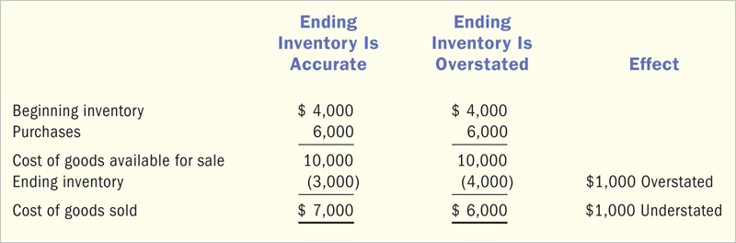
If Ending Inventory is overstated then Cost of Goods Sold will be understated.
6-49
Notes:
49
This is an example of what happens to the income statement when ending inventory is overstated by one thousand dollars.
Notice that both the income statement and balance sheet have errors The inventory, total assets, retained earnings, and total stockholders’ equity all have errors in them resulting from the single overstatement of ending inventory.

Slide 50
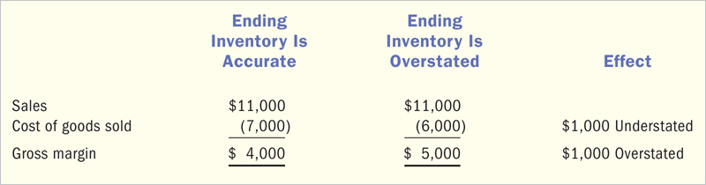
If Cost of Goods Sold is understated, then Gross Margin is overstated.
Resulting in overstatement of Net Income.
6-50
Notes:
50
If Cost of Goods Sold is understated, then Gross Margin is overstated resulting in an overstatement of net income.

Slide 51
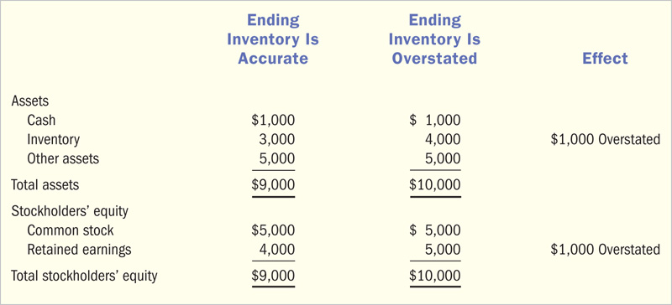
Then, on the balance sheet Inventory is overstated and Retained Earnings is overstated.
6-51
Notes:
51
On the balance sheet, inventory is overstated and retained earnings is overstated.

Slide 52
For interim financial statements, we may need to estimate ending inventory and cost of goods sold.
Notes:
For interim financial statements, we may need to estimate ending inventory and cost of goods sold.

Slide 53
Estimating the Ending Inventory Balance
Many companies use the gross margin method to estimate the current period’s ending inventory.
Notes:
Many companies use the gross margin method to estimate the current period’s ending inventory.

Slide 54
Gross Margin Method of Estimating Inventory
Provides an estimate
Not acceptable for GAAP
When to use
  for interim (any period less than a year) reporting purposes
  when physical inventory not possible (casualty)
  a check on the accuracy of the physical count
  do we have a problem with theft?
Notes:
5
One way to use the gross margin method has the following four steps.
1.) calculate the expected gross margin ratio using prior period’s income statement.
2.) multiply the expected gross margin ratio by the current period’s sales to estimate the amount of gross margin.
3.) subtract the estimated gross margin from sales to estimate cost of goods sold.
4.) subtract the estimated cost of goods sold from the amount of goods available for sale to estimate the ending inventory.

Slide 55
Example:
Given the following:
Beginning Inventory $ 1,000 (cost)
Purchases 9,000 (cost)
Sales 12,000 (retail)
Assume that gross margin has been 40% of sales. Estimate the cost of inventory and CGS for the period.
Notes:
6
Here is another (more visual) way of using the gross margin method

Slide 56
If the Gross Margin rate is 40% what is the Cost of Goods Sold %?
Net Sales 100%
Less: Cost of G.S. X%
=Gross Margin 40%
= 60%
Use these %’s and a partial multi-step income statement format to find the “missing” amounts.
Notes:
7

Slide 57
Use given amounts and known %’s
Sales $12,000
Less: Cost of Goods Sold:
Beg. Inv. $1,000
+ Purchases, net 9,000
Goods Avail. 10,000
- End. Inv. (?)
Cost of Goods Sold (60% x Net Sales)
Gross Margin $ (40% x Net Sales)
Notes:
7

Slide 58
Use given amounts and known %’s
Sales $12,000
Less: Cost of Goods Sold:
Beg. Inv. $1,000
+ Purchases, net 9,000
Goods Avail. 10,000
- End. Inv. (?)
Cost of Goods Sold (60% x Net Sales)
Gross Margin $ 4,800 (40% x Net Sales)
Notes:
7

Slide 59
Use given amounts and known %’s
Sales $12,000
Less: Cost of Goods Sold:
Beg. Inv. $1,000
+ Purchases, net 9,000
Goods Avail. 10,000
- End. Inv. (?)
Cost of Goods Sold (60% x Net Sales)
Gross Margin $ 4,800 (40% x Net Sales)
Notes:
7

Slide 60
Use given amounts and known %’s
Sales $12,000
Less: Cost of Goods Sold:
Beg. Inv. $1,000
+ Purchases, net 9,000
Goods Avail. 10,000
- End. Inv. (?)
Cost of Goods Sold (7,200) (60% x Net Sales)
Gross Margin $ 4,800 (40% x Net Sales)
Notes:
7

Slide 61
Use given amounts and known %’s
Sales $12,000
Less: Cost of Goods Sold:
Beg. Inv. $1,000
+ Purchases, net 9,000
Goods Avail. 10,000
- End. Inv. (2,800)
Cost of Goods Sold (7,200) (60% x Net Sales)
Gross Margin $ 4,800 (40% x Net Sales)
Notes:
7

Slide 62
Financial Statement Analysis
Inventory Turnover
Cost of Goods Sold
=
$ Inventory*
Inventory Turnover
Often the AVERAGE inventory is used as the denominator.
Beginning Inventory + Ending Inventory
2
Ave. Inv =
This ratio is often used to measure the liquidity (nearness to cash) of the inventory.
Notes:
4
The inventory turnover ratio measures how quickly a company sells its merchandise inventory.
It is calculated as cost of goods sold divided by inventory.
This is the first step in calculating the average number of days to sell inventory.

Slide 63
Inventory Ratios
Inventory Turnover: (A measure of how fast
inventory sells. Higher is better.)
Cost of Goods Sold $30,000
Inventory $ 5,000
=
= 6.0 times
Average Days in Inventory: (How many days go by between the time inventory arrives and it is sold?)
365 365
Inventory Turnover 6.0
=
= 60.8 days
Generally, lower means better.
Notes:
The average number of days to sell inventory measures how many days, on average, it takes to sell inventory.
It is calculated as 365 divided by the inventory turnover.
Other things being equal, the company with the lower average number of days to sell inventory is doing better.

Slide 64
End of Chapter Five
Notes:
In this chapter we introduced four inventory cost flow methods:
Specific identification
First-in, first-out
Last-in, first-out and
Weighted average.

